Slide 1
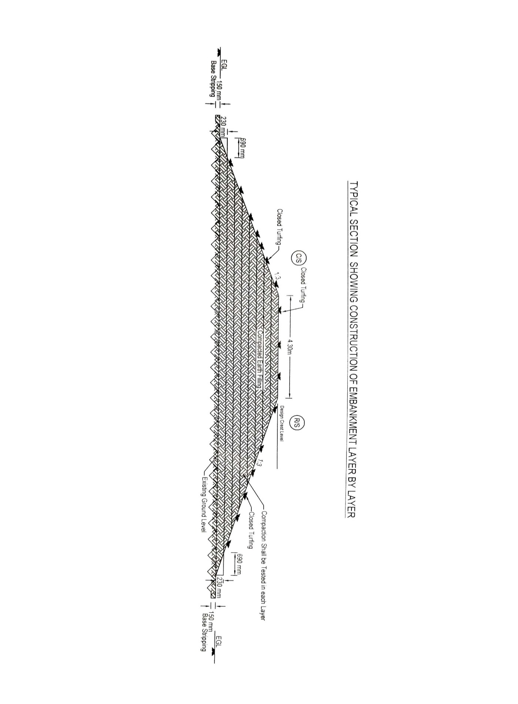

Slide 2
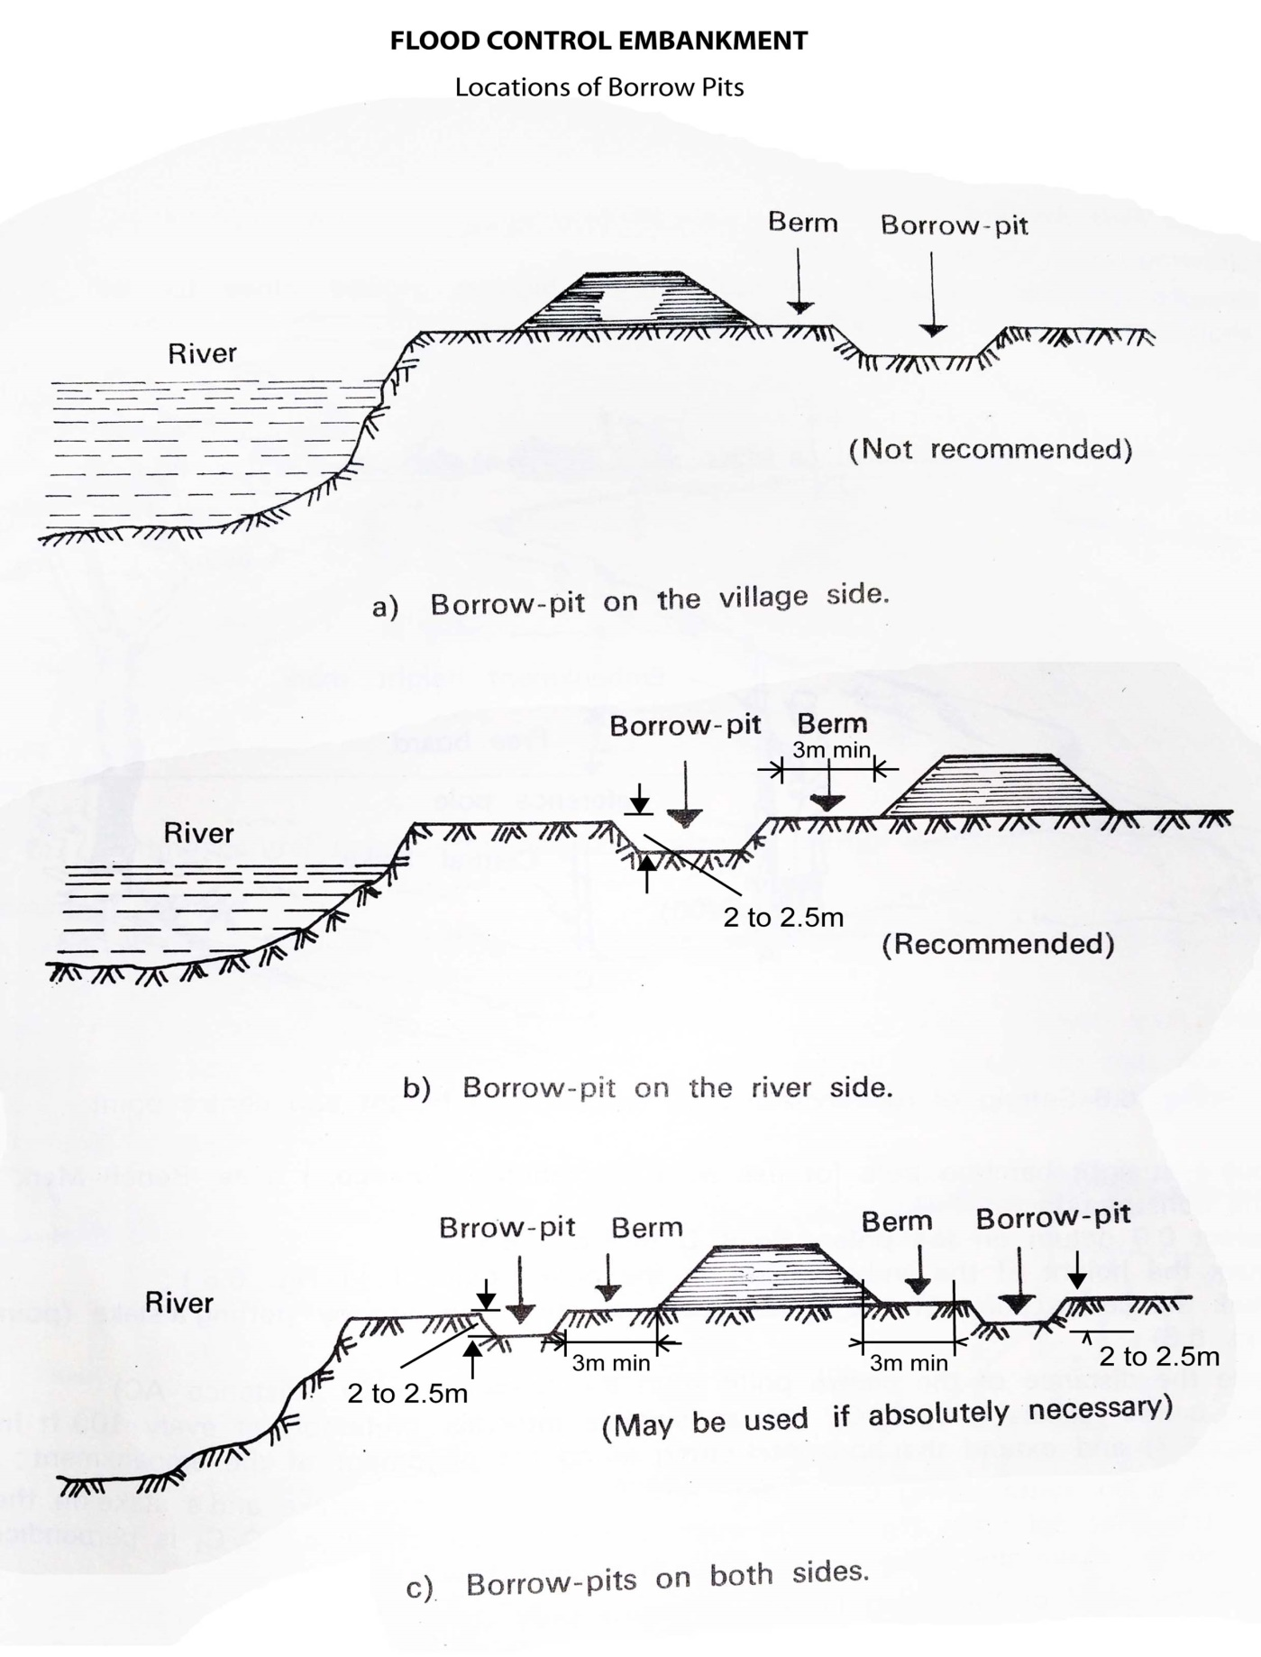
Location of Borrow Pits from The Toe of Embankment
(a) If Earth is Borrowed From The Country Side
20 m

Slide 3
Location of Borrow Pits from The Toe of Embankment
(b) If Earth is Borrowed From The River Side
20m

Slide 4
Location of Borrow Pits from The Toe of Embankment
(c) If Earth is Borrowed From Both Side
20m
20m

